Slide 1
BROWARD COUNTY GO SOLARFEST
ACCESSING AFFORDABLE SOLAR FINANCING THROUGH PACE

Slide 2
BROWARD GO SOLAR FEST
Solar Power is not the energy source of the future
This is a misconception and limits the widespread adoption of solar power
It is an energy source of today and has been in use for a long time

Slide 3
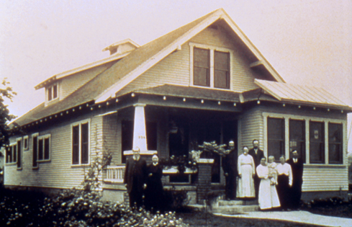
BROWARD GO SOLAR FEST
CALIFORNIA 1906

Slide 4
BROWARD GO SOLAR FEST
Everyone understands the benefits of solar
Economic – free energy
Environmental – clean energy
So if everyone understands it, and it isn’t some futuristic technology, then why isn’t everyone using it????
Simple Answer: The upfront expense

Slide 5
BROWARD GO SOLAR FEST
The industry is now a pre-pay model
All expenses are loaded on to the front end rather than spread throughout the life of the installation
Cell Phone Example
Pay as you go model
Current solar installation normally costs around $4 a watt or $4000/kw (not including battery backups)
Good News is that price has been coming down significantly in past years and cost of traditional energy has been increasing, but for the moment, still quite expensive.

Slide 6
BROWARD GO SOLAR FEST
Typical home would need a 5-7kw array
$20k - $28k
Some go as large as 10kw array ($40k) to be completely off grid or to power larger appliances such as HVAC systems
These amounts don’t include battery backups
For many, it is an obvious decision….spend $28,000 now in order to save a couple hundred bucks a month…..the decision is NO
Especially in states like Florida where our cost of energy is actually rather low compared to other states and countries

Slide 7
BROWARD GO SOLAR FEST
Many concepts have been implemented in order to avoid this problem and remove this obstacle to widespread solar adoption
State Subsidies
No longer exist in Florida
Federal Tax Credits
Up to 30% of value of installation, set to expire in 2016
Utility Company Rebates
Limited funds that dry up quickly
May increase due to recent Obama Executive Order
PPA’s (Power Purchase Agreement)
Not available in Florida
Leasing
On-bill Financing
Net Metering
PACE

Slide 8
THE BASICS OF PACE
MUNICIPALITIES CAN FINANCE ENERGY EFFICIENCY, HURRICANE PROTECTION, AND RENEWABLE ENERGY UPGRADES FOR PRIVATE PROPERTY OWNERS
REPAID BY THE PROPERTY OWNER THROUGH NON-AD VALOREM ASSESSMENT ON PROPERTY TAX BILL
NEW SPIN ON THE ASSESSMENT POWERS OF THE CITY
ENERGY EFFICIENCY, RENEWABLE ENERGY, AND HURRICANE PROTECTION = COMPELLING STATE INTEREST

Slide 9
WHAT IS PACE?
100% FINANCING
No out of pocket expense to property owner
Removes single largest obstacle to implement these projects
VOLUNTARY
Simply an option for those who want it
All traditional forms of financing are still available
INDIVIDUAL
Zero affect on neighbors
Only those who choose to participate pay the assessment
NON CREDIT BASED
Eligibility based on property values and owner equity
Allows many to participate that would not be eligible for traditional financing

Slide 10
PACE
All of a sudden, with these programs, solar makes economic sense for home owners and businesses
With PACE alone, you can now get a $20,000 installation for only $1900 a year ($158 a month) with nothing out of pocket for the first year.
Now imagine that you get a rebate from FPL and tax credits totaling $10,000. So you can have a $20k installation for about $900 a year ($75 a month). Depending on the efficiency of your home, the solar installation can be cash flow positive as of day one.

Slide 11
EXTRA BENEFITS OF PACE
Not just a solar program
Can be used for the entire building envelope - insulation, windows, efficient air conditioners, radium barrient, window film, etc.
This means that you can now have zero out of pocket expense to make the entire building more efficient so you don’t waste money on a larger array than necessary
Can pass along with ownership of the property
Easy to qualify
Long payback periods (up to 20 years)
Makes annual payment very affordable
In the case of commercial properties, full payment can be expensed (Off Balance Sheet)
No cost to the cities/No increase in utility rates

Slide 12
PACE IN FLORIDA
Florida has been slow to adopt the program
There are two active PACE districts running in Florida today
Palm Beach County
Green Corridor in Miami-Dade County has completed almost 60 projects for over $2 million
150 more projects in construction
Consists of 8 cities – Miami, Coral Gables, Miami Shores, Cutler Bay, Pinecrest, South Miami, Palmetto Bay, and Key Biscayne
Second district coming online in Miami-Dade at the end of June
Coastal Corridor – Surfside, Bay Harbor Islands, Biscayne Park, North Bay Village
Broward County vote to join the District set for June 24
Pinellas County and Leon County have voted to create a program but still in the works

Slide 13
Thank you

