Slide 1
Solar Energy Overview
JM Family Enterprises
June 2014

Slide 2
JM Family Photovoltaic Systems
1
DataScan , Alpharetta GA
2
100 Building, Deerfield FL
3
500 Building, Deerfield FL
4
JM Lexus Service Center, Margate FL
5
JM Lexus New Car Showroom/Sales, Margate FL
6
111 Building, Deerfield FL
7
190 Building, Deerfield FL
8
Youth Automotive Training Center, Deerfield FL

Slide 3
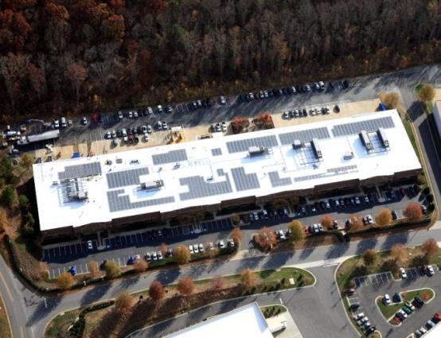
DataScan
Commission Date: Jan. 20 , 2011
202 kW power capacity
1,110 solar modules
ROI 7 yrs

Slide 4
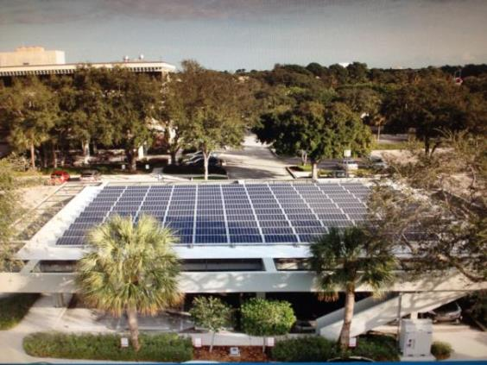
100 Building Covered Parking
Commission Date: Nov. 18, 2011
33 kW power capacity
131 solar modules
ROI 7 yrs

Slide 5
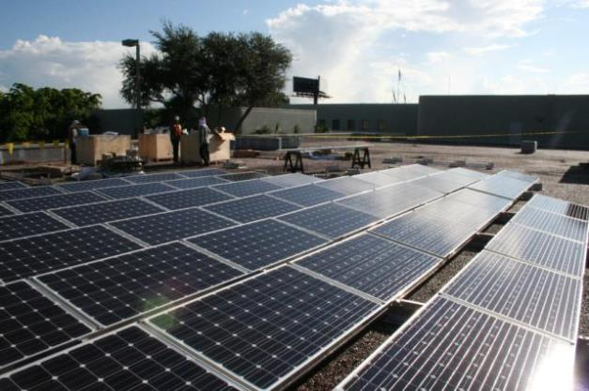
500 Building
Commission Date: Dec. 1, 2011
33 kW power capacity
131 solar modules
ROI 7 yrs

Slide 6
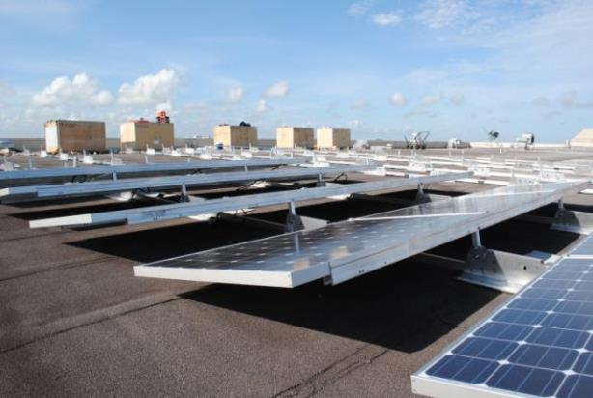
JM Lexus Service Center
Commission Date: Nov. 18, 2011
33 kW power capacity
131 solar modules
ROI 7 yrs

Slide 7
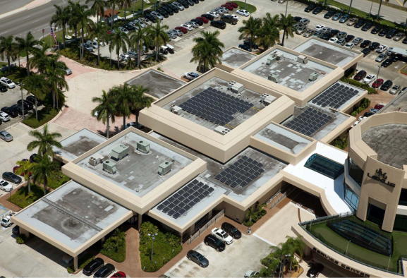
JM Lexus New Car Showroom
Commission Date: March 14, 2013
56 kW power capacity
221 solar modules
ROI 7 yrs

Slide 8
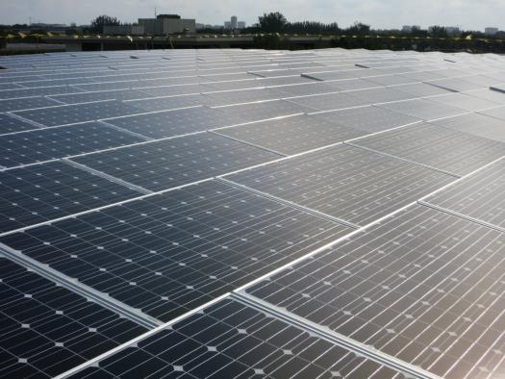
111 Building
Commission Date: Pending
146 kW power capacity
552 solar modules
ROI 6 yrs

Slide 9
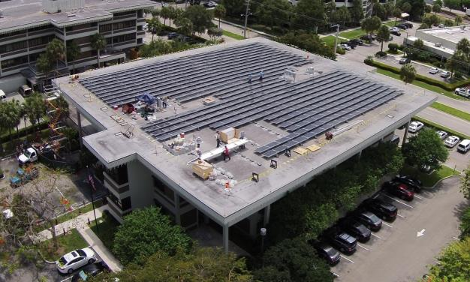
190 Building
Commission Date: Pending
146 kW power capacity
552 solar modules
ROI 7 yrs

Slide 10
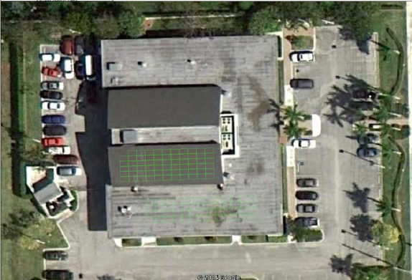
Youth Automotive Training Center
Commission Date: TBD
31 kW power capacity
117 solar modules
ROI 6 yrs

Slide 11
Challenges
Roof access and noise during business hours installation
Roof Attachment Methods ie post-tension concrete deck
Insurance company standards not established
Permitting challanges
End of utility rebate program

Slide 12
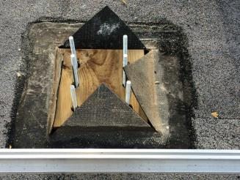
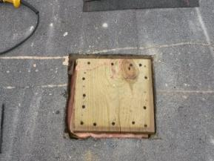
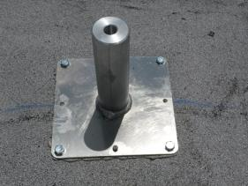

Slide 13
2013 SOLAR PV PERFORMANCE RATIO
Combined 2013 average 99.6%

Slide 14
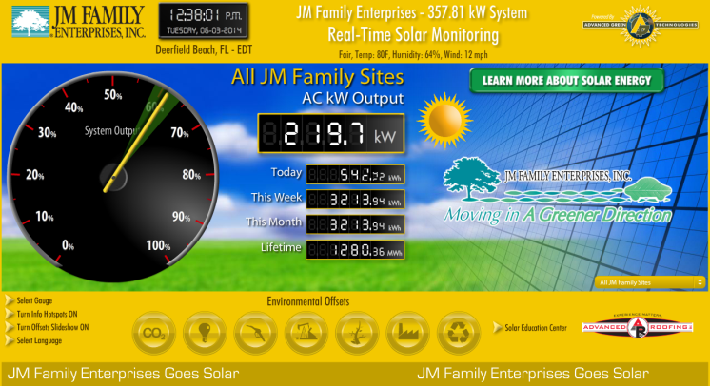
Solar Production Monitoring
JMFEsolar.com
Real-time output monitoring
1,000 MWh production since 2011 inception

Slide 15
Suggestions
Demonstrate cost effectiveness
Verify vendor experience
Provide progress updates and photos
Offer solar installation tours

Slide 16
JMFE Solar System Parameters
Power capacity of array does not exceed building consumption.
Components are "Buy American” compliant.
ROI of 7 yrs. or less based solely on cost of power and incentives.
Meets FM Global requirements.
Meets JM standards above and beyond building code, including safety, functionality, resiliency, longevity, and aesthetics.
System maintained by JMSC.
Turn key installation per JM contract and insurance requirements.
Industry standard guarantee and material warranties.

