Slide 1
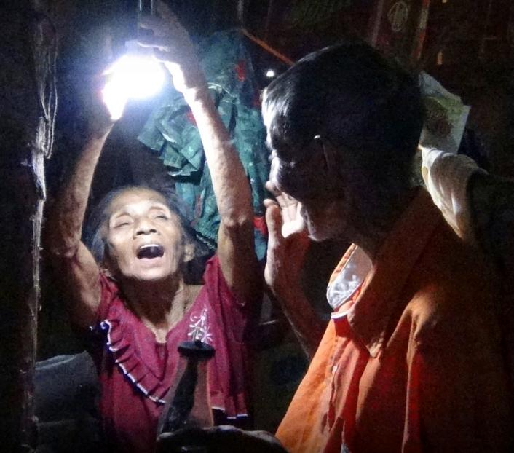
“SOLAR’S ON THE MOVE”
OFF GRID PV SYSTEMS FOR RURAL ELECTRIFICATION, BACK UP POWER, OUTDOOR AND RECREATIONAL ACTIVITIES

Slide 2
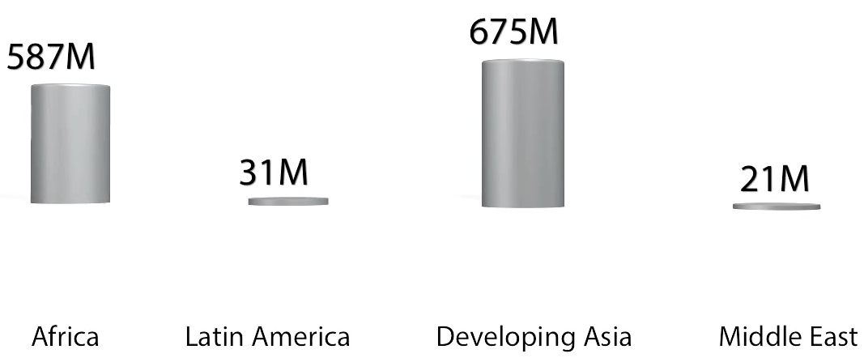
Over 1.2 Billion People 20% Of The World's Population
Are Still Without Access To Electricity Worldwide, not counting all the areas that are in constant struggle with natural disasters.

Slide 3
“Access To Electricity Must Be Environmentally
And Socially Sustainable”
Without Access To Energy Service, People Will Be Deprived Of The Most Basic Of Human Rights And Of Economic Opportunities To Improve Their Standard Of Living.

Slide 4
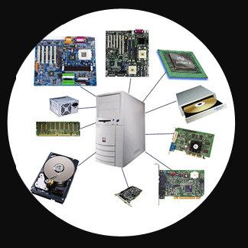
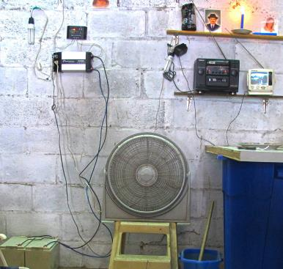
Comparison Of The Evolution Between Computers And PV Systems
Old cloned computers | Nowadays PV systems

Slide 5
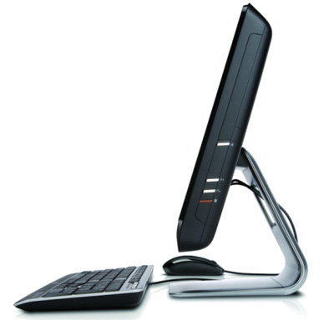
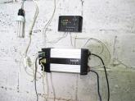
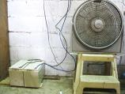
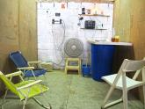
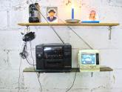
Comparison Of The Evolution Between Computers And PV Systems
Actual Computers | Actual Off-Grid Installation (Unorganized)

Slide 6
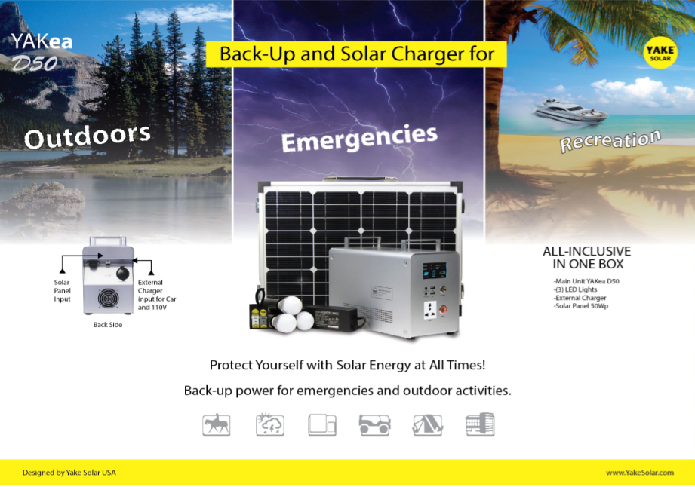
BACK-UP POWER FOR EMERGENCIES
&
OUTDOOR ACTIVITIES

Slide 7
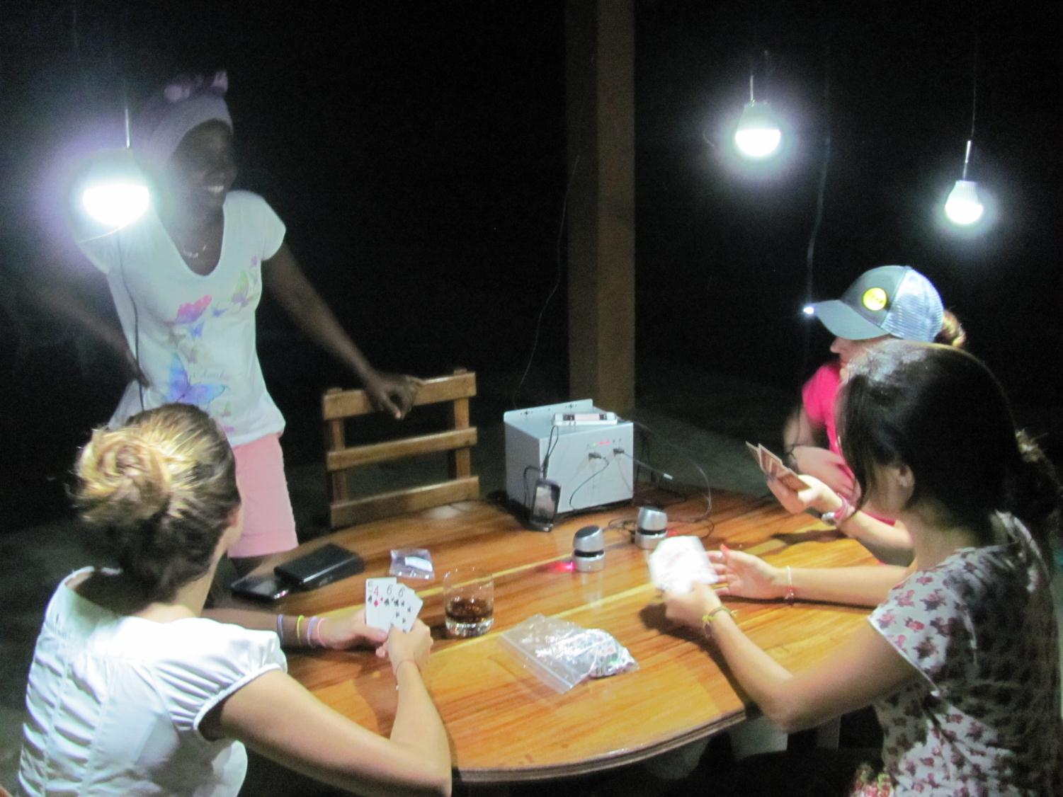

Slide 8
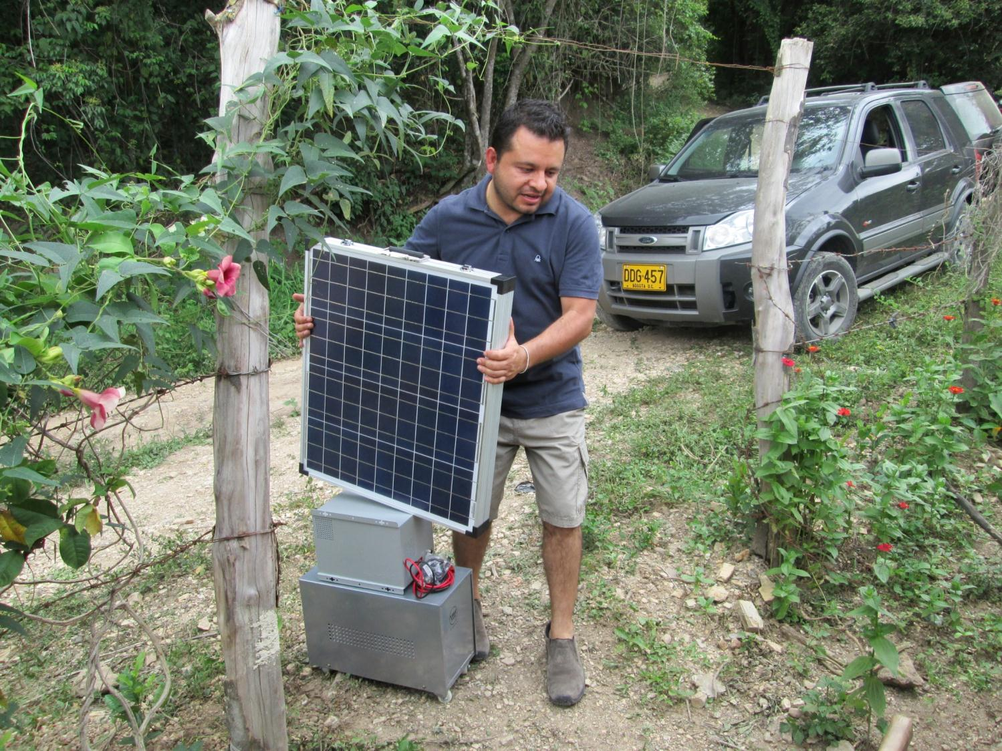

Slide 9
OVERSIGHTS
Without the utility as a supplemental electricity source, a PV system’s sizing is critical.
Power Usage- how to determine what system is needed.
Off-grid systems require their owners’ participation—this means living within the original design’s energy budget, planning for future growth, and having a backup energy source for times of high energy usage or low solar production.
All maintenance and equipment servicing is also done on-site, at the homeowner’s expense, and by the homeowner or installer-instead of by a power company.

Slide 10
KEY HAZARDS:
Working at heights
access
falls from heights
falling objects
Electrical
discharge from uninstalled panels (importance use of connectors like MC4, PLT & ANDERSON type)
electrical wiring, electrical fittings and electrical equipment
Connection between the batteries to main unit (importance of a super-cable)
Input and output protection (access to fuses and breakers/ kids or animal protection)

Slide 11
Roof surfaces
slippery glazed tiles or tiles with algae or moss deposits
roof pitch/slope
damaged roofing/fragile roofs/brittle roofing
Installation of PV rack structures in slope roofs
Manual handling
(plug-and-play functionality / easy & simple philosophy )
Weather conditions
time of installation
wet, cold, icy, windy or hot days

Slide 12
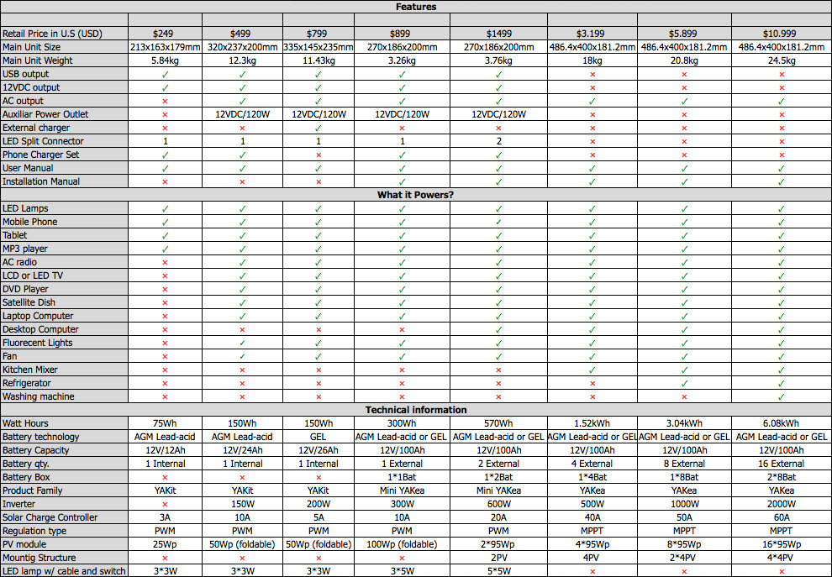
Comparison Guide « Power Usage »

Slide 13
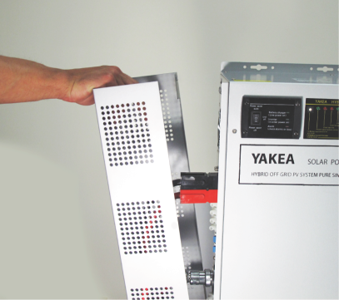
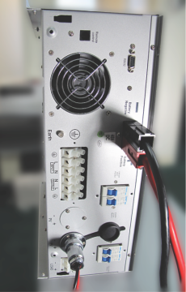
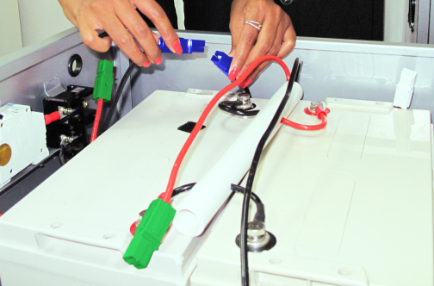
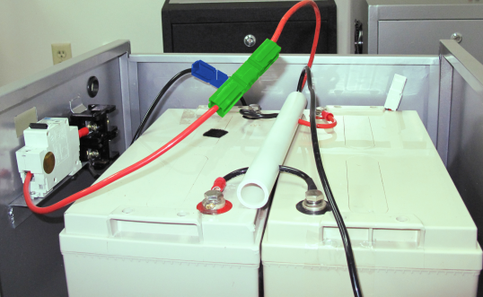
RISKS & SAFETY FEATURES

Slide 14
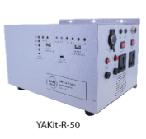
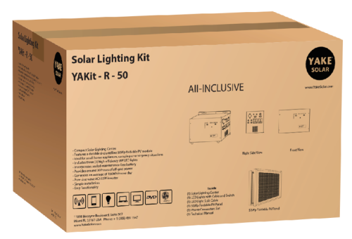
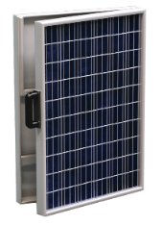
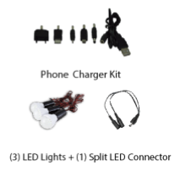
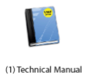
All-in ONE BOX

Slide 15
1) Input
Solar charge the Mini YAKea R-100 through the 100Wp foldable solar module
2) Output
Recharge your smartphone, tablet, MP3 player or power your lights, radio, LCD/LED TV, DVD player and many more in just seconds.

Slide 16
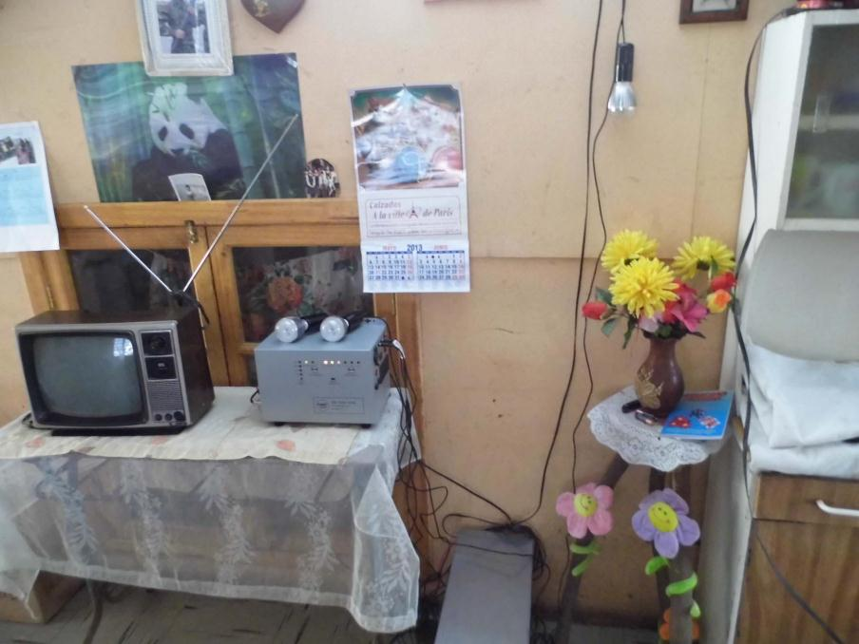
Off-grid Consumers Need To Be Aware Of Their Energy Allowance And Shop Carefully For Efficient Appliances.

Slide 17
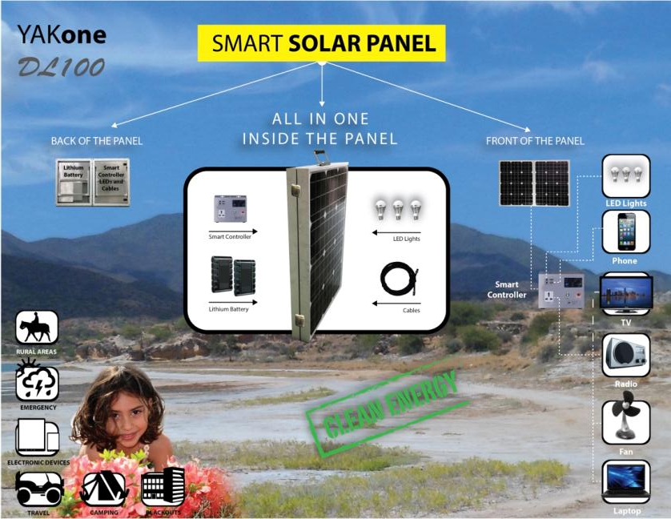
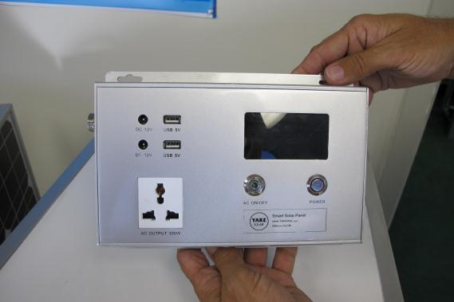
A New Design Concept
Imaging A System Where All Needed Components
Are Part Of The PV Module Itself.

