Slide 1
Learning to be Green: Sustainability Education and Research at FIU
Cheng-Xian (Charlie) Lin, Ph.D.
Department of Mechanical and Materials Engineering
College of Engineering and Computing
Florida International University
Miami, Florida 33174
June 6, 2014

Slide 2
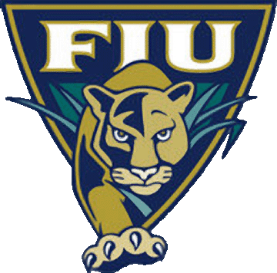
About FIU
Enrollment: 50,396 (Fall 2012)
Largest Hispanic Serving Institution in the U.S.
7th largest public university in the U.S.
Campuses
Modesto A. Maidique Campus, Biscayne Bay Campus
Broward Pines Center, Engineering Center, Downtown Brickell, Miami Beach Urban Studios, Wolfsonian FIU
180 Majors in 23 Colleges and Schools
College of Architecture + The Arts
College of Arts & Sciences
College of Business
College of Education
College of Engineering and Computing (for more information, please visit FIU CEC Both #204 at Go SOLAR Fest)
College of Law
Herbert Wertheim College of Medicine
Nicole Wertheim College of Nursing & Health Sciences
Chaplin School of Hospitality and Tourism Management
School of Journalism and Mass Communications
Robert Stempel College of Public Health and Social Work

Slide 3
What is Sustainability ?
Sustainable (adjective): able to last or continue for a long time.
Merriam-Webster.com
A sustainable world is one in which human needs are met equitably without harm to the environment, and without sacrificing the ability of future generations to meet their needs.
National Science Foundation
Sustainable development is economic growth that will benefit present and future generations without detrimentally affecting the resources or biological systems of the planet.
President's Council on Sustainable Development

Slide 4
Dimensions of Sustainable Systems
Sustainable Systems
Environmentally sound
Socially just
Economically viable
The roles of renewable energy technology in sustainability
Protect environment
Create jobs
Could generate return on investment (ROI)

Slide 5
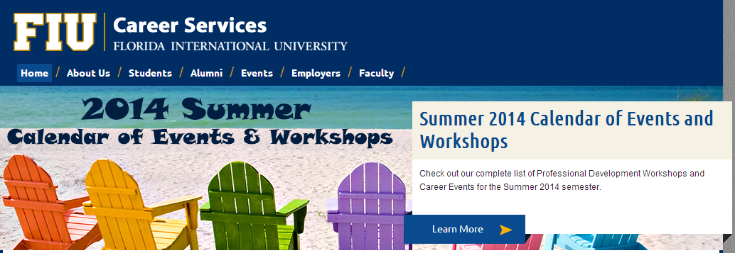
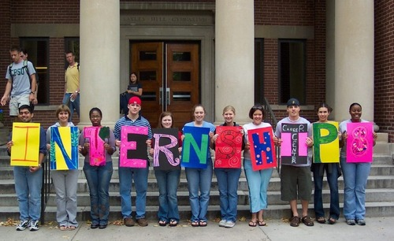
FIU Career Services
Career Opportunities
Career Fairs: 4 per year
Internships - Students
Internship Fair - Employers
Employer Information Sessions & On Campus Interview
Career Development
Professional Development Workshops
Practice Interview Program
Career Boot Camp & MEGA Career Week
Executive Protégé Initiative
Others (visit career.fiu.edu)

Slide 6
Green Jobs ?
Job Database at FIU Career Services
Collect all types of open jobs, including green jobs, for FIU students only
Search “Green Jobs”: 114 hits
Search “Solar Energy”: 11 hits
(Date: May 14, 2014)
Green Jobs in Florida Expected to Continue to Grow
Rich Resources
Solar, biomass, and ocean hydro renewable energy
Growing Driving Forces
Population growth: soon to become the 3rd largest state
Support from government and local business
Awareness from consumers

Slide 7
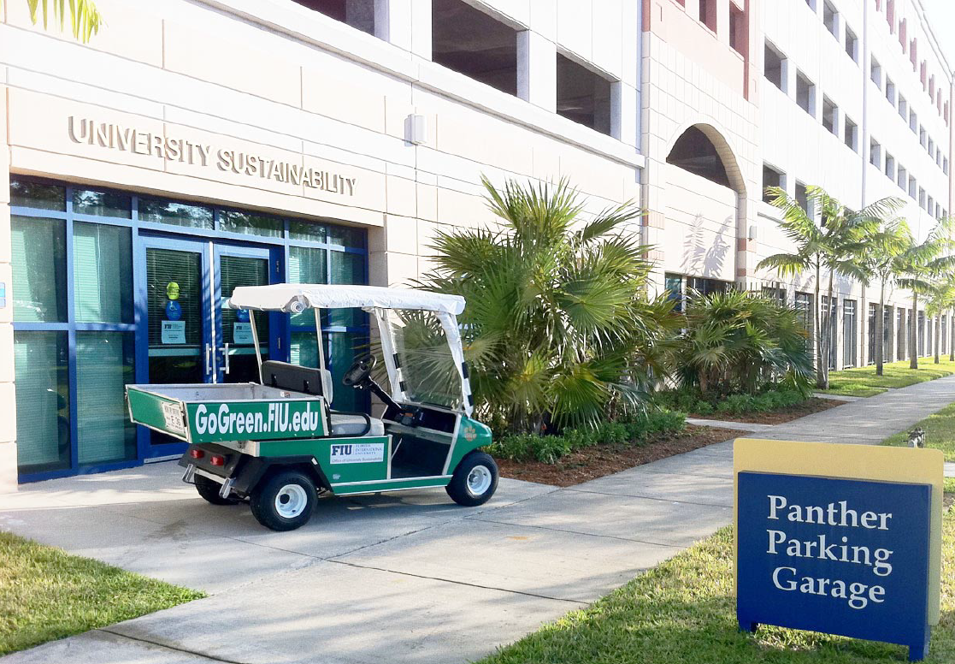
FIU Campus Sustainability (Coordinated by Office of University Sustainability)
Office of University Sustainability
(gogreen.fiu.edu)
Focus Areas
Energy
Waste
Transportation
Outreach

Slide 8
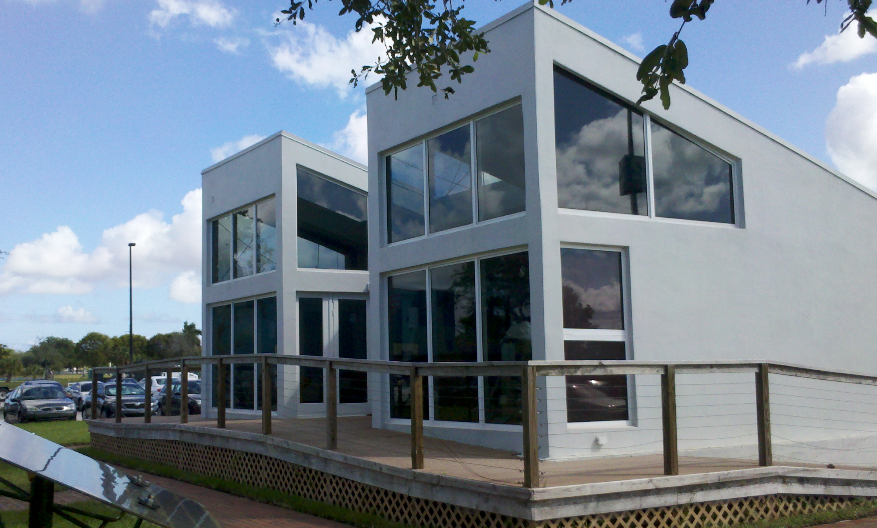
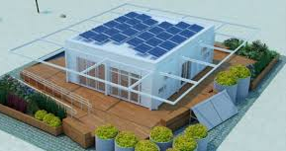
Campus Sustainability-Energy
Solar PV
Solar PV array installed on top of SIPA building
Solar PV powered houses designed and built by students
2005 Solar Decathlon
2011 Solar Decathlon
Energy efficiency
Facilities Management’s implementation of various energy conservation measures and efficiency upgrades
All new buildings certified as a minimum LEED Silver
Motion detector lighting switches installed in offices and classrooms
Temperature adjusted to 75 ºF in all buildings (7-10% savings)
Ranked No. 1 out of all the Florida State University System Institutions

Slide 9
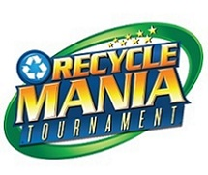
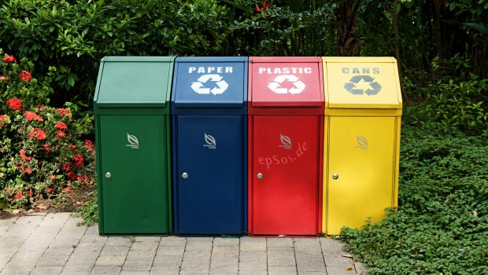
Campus Sustainability-Waste
FIU Recycles
RecycleMania
A national competition
Campus Recycling
Single Stream Recycling
Specialized Recycling Stream
Give and GoGreen
FIU Game Day Recycling
Event Recycling

Slide 10
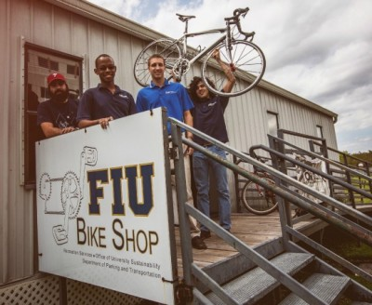
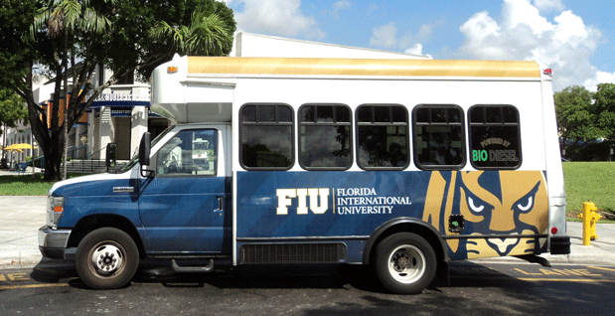
Campus Sustainability-Transportation
Bike Shop and Biking
Carpool Program
Public Transportation
Miami Dade Transit
Shuttle Buses
Ticket-less Bus System
FIU Fleet
Entirely switched to 20% Bio-diesel splash in 2009

Slide 11
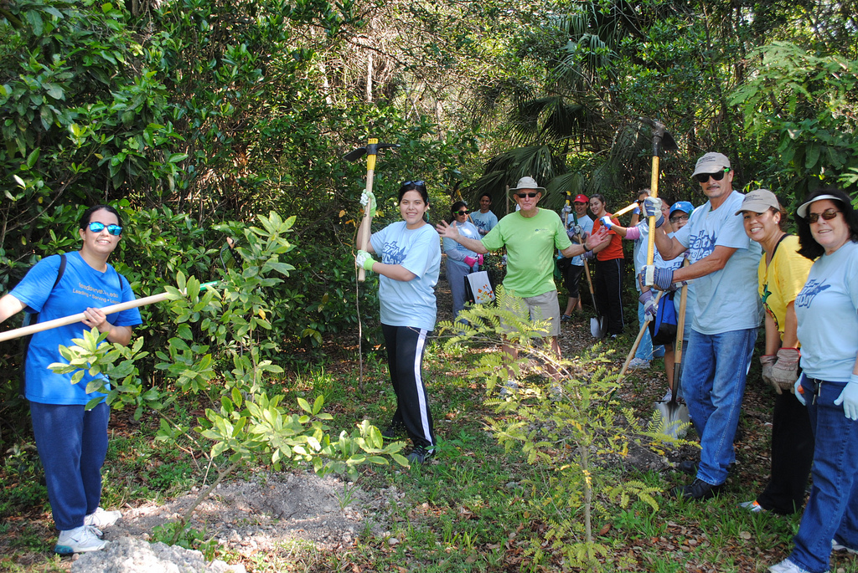
Campus Sustainability-Outreach & Others
The FIU Natural Preserve
14-acre environmental education facility
Student education and volunteer
Green Office Certification Program
Sustainability 101 Training
Professional development credit
Tree Campus
1ST in Florida to become a certified Tree Campus USA with Arbor Day Foundation
Many Other Campus Programs

Slide 12
Courses Offered about Sustainability (as of July 2013)
Sustainability Focused Courses
Undergraduate courses: 20
Sustainability Related Courses
Undergraduate courses: 243
Graduate courses: 118
New Sustainability Courses
Being developed & to be updated

Slide 13
Energy and Sustainability Related Programs in FIU’s MME Department
B.S., M.S., and Ph.D. Degrees
Senior Design Projects (B.S.)
Theses/Dissertations (M.S. or Ph.D.)
Energy and Sustainability Certificate (New)
Undergraduate Program
Five Courses: 15 Credit Hours
Energy Systems
Introduction to Turbomachinery
Introduction to Environmental Economics
Power Systems I
Sustainable Approach to Construction

Slide 14
Research on Energy and Sustainability
Sustainable Energy and Thermal Transport Systems Laboratory
(Director: Dr. C.X. Lin, lincx@fiu.edu, 305-348-0537)
Solar Energy Utilization
Hybrid PV/T Technologies
Solar House
HVAC
Building Energy Simulation
Waste Heat Recovery
Others
Other FIU Faculty Research (visit www.fiu.edu)
FY2013 Research Projects Related to Sustainability: 117

Slide 15
Final Remarks
Green University’s Positive Environmental Impact
Minimize institutional carbon footprint on the planet
Reduce cost of living and education in the long run
Produce sustainability-aware next generation work force

