Slide 1

Solar Implementation in SE Florida: Go Solar Florida
Dec 10, 2013 RCAP Implementation Workshop
“Catalyzing Solar Development and Implementation in Southeast Florida

Slide 2
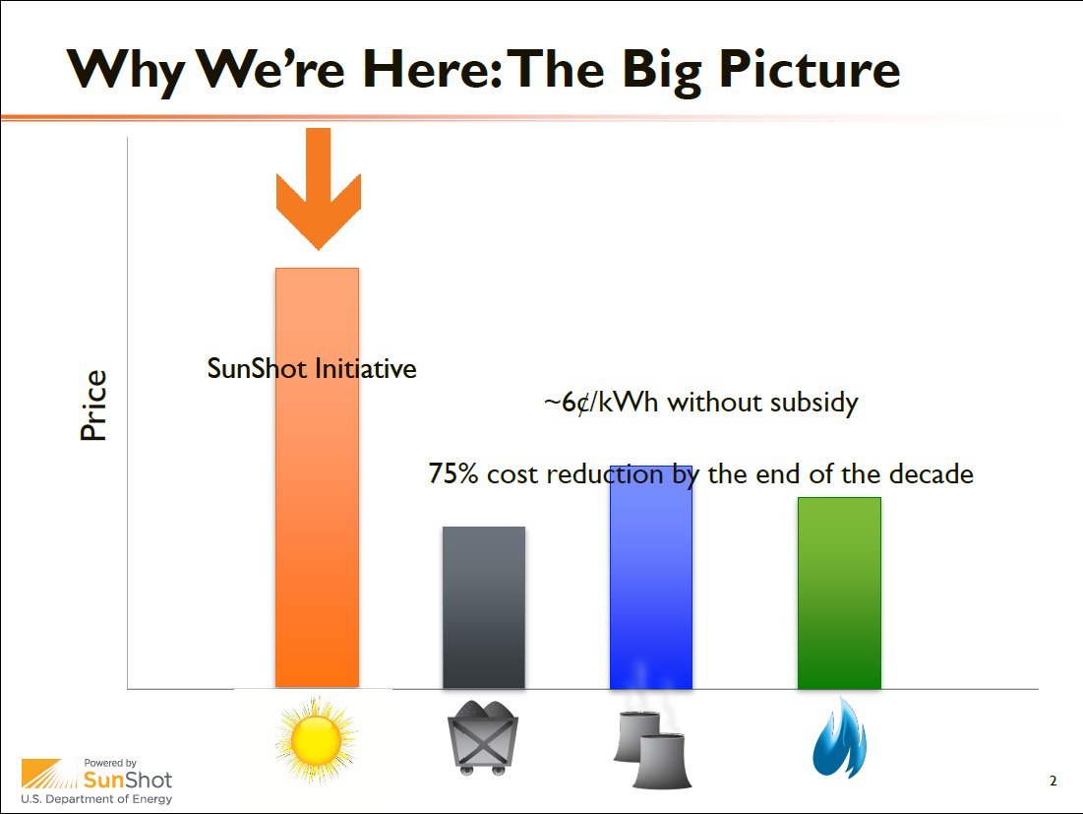

Slide 3
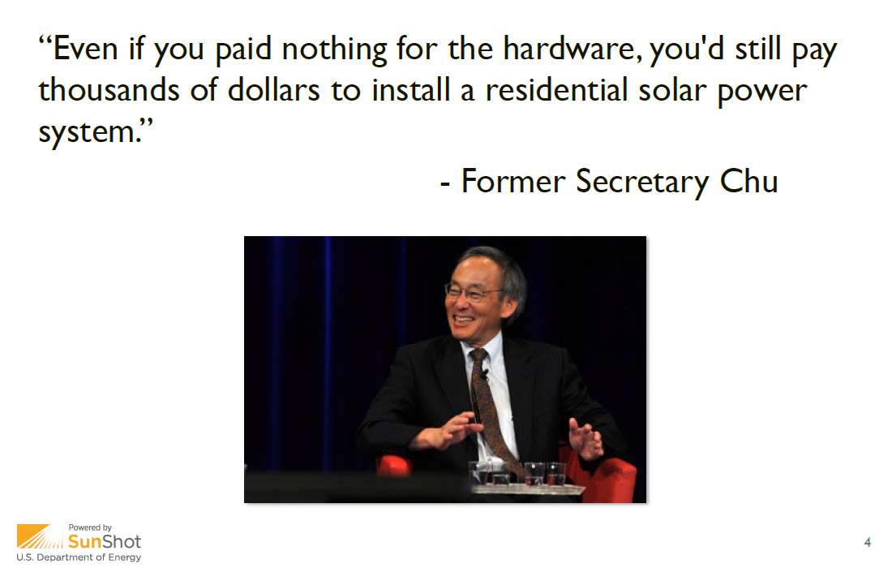

Slide 4
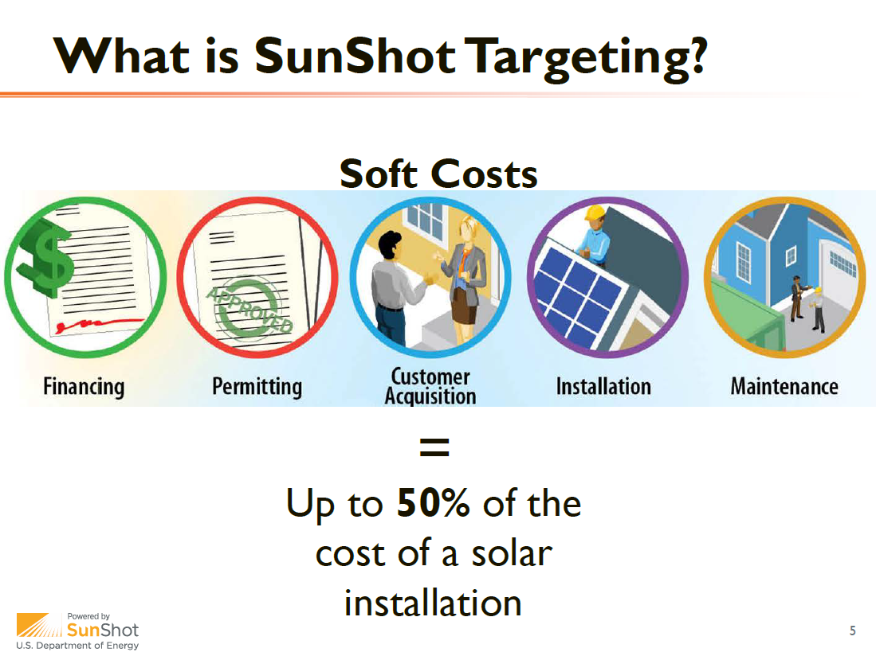

Slide 5
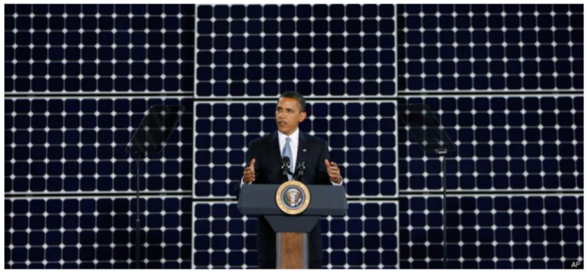
What is Go SOLAR
Florida Rooftop Solar Challenge?
U.S. Department of Energy Grant
Broward County and
  23 Broward partner cities
  5 partner counties
  The City of Venice
  Collaborating to make solar rooftop systems easier, faster and cheaper for residents and businesses
    Through streamline permitting, engineering and regulation
Notes:
What is Go SOLAR?:
It’s a US Department of Energy grant awarded to Broward County to find ways to make it easier, faster and cheaper to install rooftop solar systems, also referred to as Photovoltaic Rooftop Systems
Broward County is one of the 22 awardees nationwide and the only one in the Southeastern United States.
The County is working collaboratively with 14 partner cities to Streamline Rooftop Solar Permitting

Slide 6
Why is Broward taking this Challenge?
Increase number of grid-tied solar installations by reducing permitting costs
Promote an ePermit environment
Encourage solar financing solutions statewide
Encourage consistent net metering and interconnection standards
Notes:
According to DOE
“Non-hardware costs associated with processes such as customer acquisition, permitting, inspection, installation, and interconnection currently make up approximately 30-40% of the total installed cost of a rooftop PV system” U.S. DOE
Permitting can be as much as 20% of the installation cost. We are doing our part to reduce some of these costs by implementing an online solar permitting system for Broward unincorporated areas and the 14 partner cities.
DOE wants to streamline permitting to reduce costs of installation and improve market conditions for solar regionally and nationwide. Solar systems are costly but this is our first step to help reduce the cost of solar installations for residents and businesses.
Bottom line – Broward County is doing Go SOLAR because it reduces customer costs in solar permitting, and is an opportunity to pilot an innovation in permitting that is the vanguard for other county epermiting programs

Slide 7
Some Benefits of
Go SOLAR
Utility company rebates up to $20,000 per system
Federal tax credit for up to 30% of residential system cost
Save on energy bill
Cleaner source of energy
Greenhouse gas reductions
Notes:
What are some of the benefits of going solar?
Our local utility company, FPL, provides rebates annually of up to $20,000 per installation.
FPL offers a rebate of $2 per direct current (DC) Watt nameplate rating of the solar panels up to a maximum rebate per premise of $20,000.
http://www.fpl.com/landing/solar_rebate/index.shtml
Federal tax credit for up to 30% of the cost of the qualified property.
Residential Energy Efficient Property Credit on qualified solar electricity equipment. The credit, which runs through 2016, is 30% of the cost of qualified property with no cap on the amount of credit available.
http://www.irs.gov/newsroom/article/0,,id=255304,00.html
This clean source of energy results in greenhouse gas(GHG) reductions in support of the Board’s climate protection policies.

Slide 8
Main Benefit - Streamlined Permitting!
Solar Contractor
Solar Contractor
Go to City to Pay Fee and Obtain Permit
Engineer Designs System
Current process
several weeks
Review Comments/
Responses Process
Apply in Person at City for Permit
Apply & Obtain Permit Online
Zoning Department
Review
Building Department
Review
Proposed Process
A Few Minutes
Notes:
The current manual permitting process is cumbersome and costly, taking several weeks.
Once an owner has contracted with a Solar Contractor, an Engineer must be retained to design the system.
Next the contractor must apply in person at the City’s Building Department.
Now the Building and Zoning Departments review the documents and provide comments
Next the Contractor and Engineer re-submit revised documents to the City for further review. Normally this takes two to three iterations before approval can be obtained.
The contractor returns to the City to pay the permit fee and obtain a printed copy of the approval package.
Processing time can be several weeks (TRANSITION IN RED LOGO)
In the Streamlined Permitting Process the Solar Contractor can obtain the permit on-line in minutes. This online system will be able to process approximately 80% of the residential and small commercial installations in Broward.
How will this be accomplished?

Slide 9
Online Permit System
Save Time: Apply online 24/7
Save Money: Select pre-approved engineered designs – eliminate complicated plan review process
One Fee: Pay standard permit fee online
Notes:
First of all, a contractor can apply on-line 24/7.
The online permitting system will contained a library of pre-engineer designs that have been pre-approved by County and participating Cities Building Officials’.
This eliminates the need to hire and pay for an Engineer to design the solar system. A substantial cost savings.
It also eliminates the current complicated, time consuming and costly plan review process
One standard permit fee has been agreed upon which can paid online. This allows the Contractor to provide an accurate cost estimate to the owner for the installation
The permit can be issued in minutes!

Slide 10
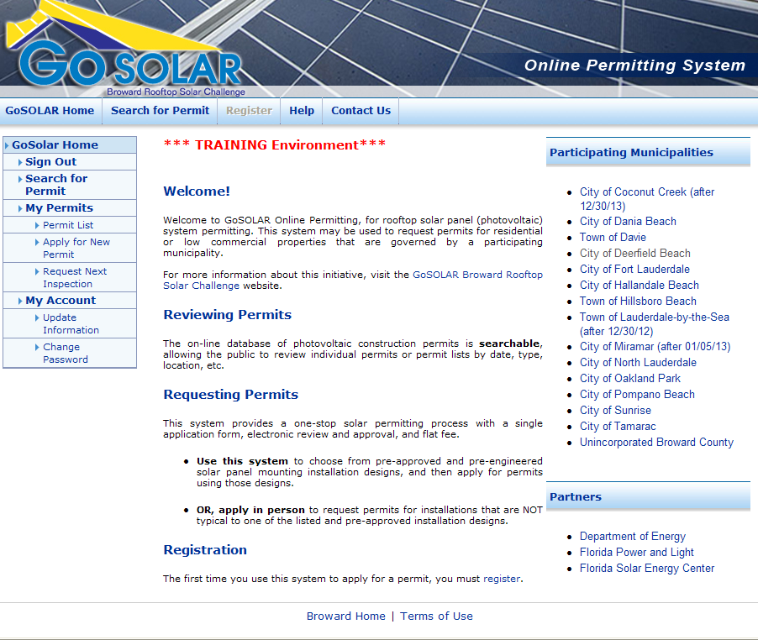
Notes:
A quick walk through of how the system will work

Slide 11
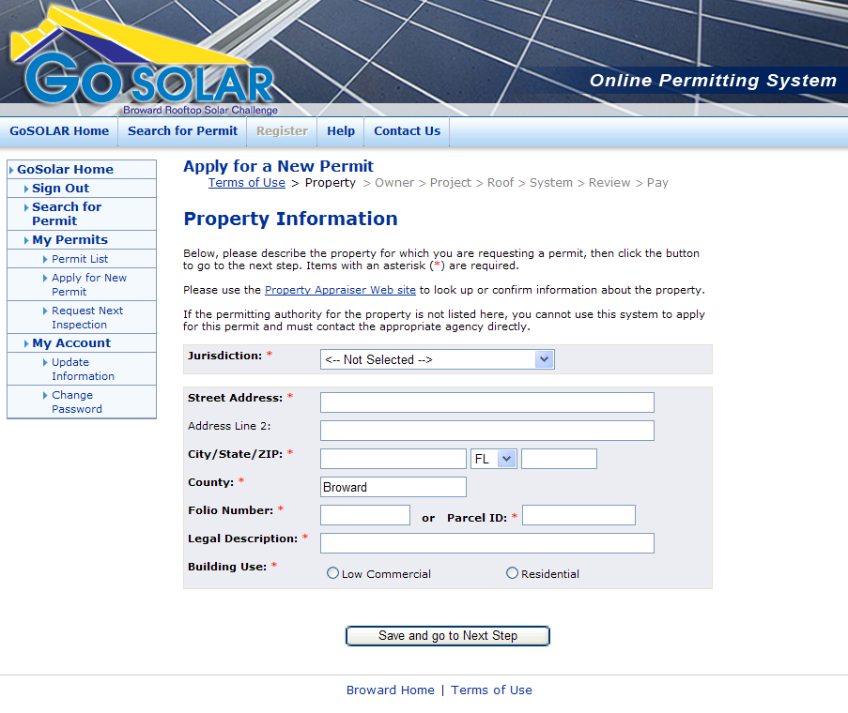
Notes:
Example of 3 Information Screens

Slide 12
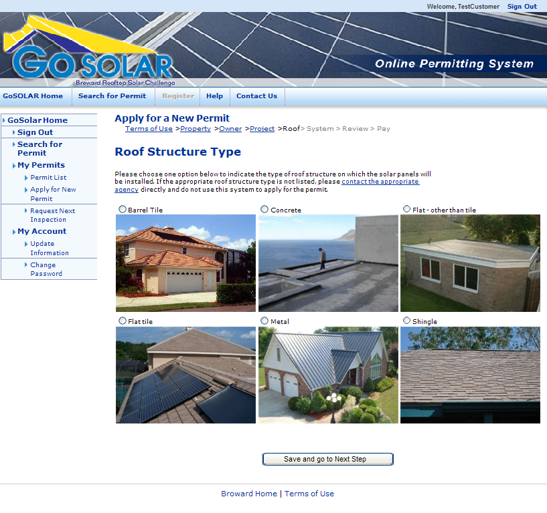

Slide 13
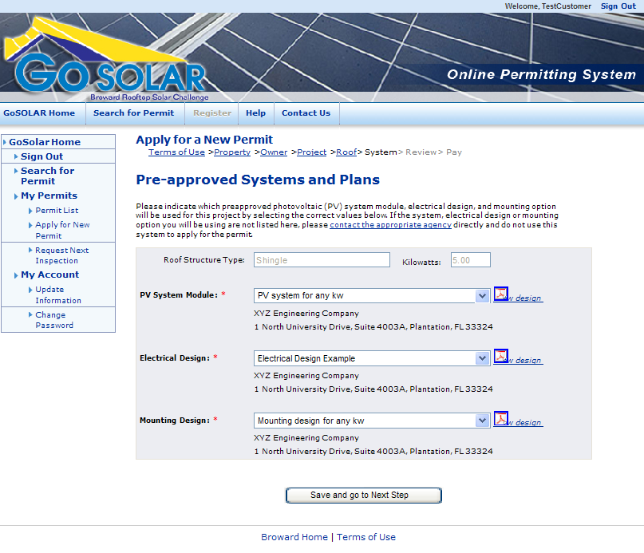

Slide 14
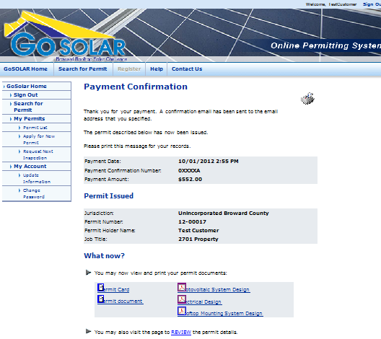

Slide 15
Rooftop Solar Challenge II
Go Solar - Florida
Add 9 municipalities to Go Solar – Broward
Refine Go Solar – Broward
Replicate Go SOLAR – Broward effort in five counties and one non-Broward city

Slide 16
Rooftop Solar Challenge II
Go Solar – Florida (cont)
With FSEC, develop long term business solution
Revise Go Solar Broward Planning and Zoning Best Management Practices
Enhance financing options for rooftop solar systems
Market, Market, Market

Slide 17
Dr. Nancy Gassman
Project Manager
Go SOLAR – Florida
Planning and Zoning
Go Solar – Broward
Go Solar – Florida
Outreach/Marketing, Go Solar Fests
Lead - Maribel Feliciano
Cathy Randazzo
Lead - Kay Sommers
Javier Acevedo
Go Solar – Florida
Financial Options
Matt Anderson
FAU
Ken Dobies
Scott Strauss
Lead – Dr. Nancy Gassman
Sean Sammon
Go SOLAR – Florida
Administration/Budget
Go SOLAR – Florida
Permitting Solutions
Lead – Admin Coord II
Lead – Dr. Nancy Gassman
Alachua County
Admin Coord II – Partners Coordination
Broward County
D’arcy Damveld-Ansel– Broward Coordination
Miami-Dade County
Monica Pognon – ASAP/Budget/FRS Qtrly Report
Monroe County
St. Lucie County
City of Venice
FSEC
Juan Gomez/Dan O’linn

Slide 18
Go/No Go
2013 | 2014 |  |  |  | 2015 |  |  |  | 2016
Q4 | Q1 | Q2 | Q3 | Q4 | Q1 | Q2 | Q3 | Q4 | Q1 | Q2
Admin
Financial
Broward Cities
Planning &
Zoning
Financial
Options
Permitting
Systems
Outreach
Project
Management

Slide 19
Permitting Collaboration
Coconut Creek
Dania Beach
Davie
Deerfield Beach
Fort Lauderdale
Hallandale Beach
Hillsboro Beach
Lauderdale-by-the-Sea
Miramar
North Lauderdale
Oakland Park
Pompano Beach
Sunrise
Tamarac
Cooper City
Hollywood
Lauderdale Lakes
Lauderhill
Lighthouse Point
Margate
Pembroke Pines
Plantation
Wilton Manors
City of Venice
Alachua
Broward
Miami-Dade
Monroe
Orange
St. Lucie
FAU
FSEC
Notes:
Left – Go SOLAR 1, Middle and Right – Go SOLAR II
Through Interlocal agreements with the 14 cities, Broward County will issue and collect permit fees for rooftop solar permits on behalf of the participating cities.
The 14 partner cities are; Coconut Creek, Dania Beach, Davie, Deerfield Beach, Fort Lauderdale, Hallandale Beach, Hillsboro Beach, Lauderdale-by-the-Sea, Miramar, North Lauderdale, Oakland Park, Pompano Beach, Sunrise and Tamarac.

Slide 20

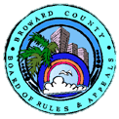







Partnerships…
Key to Success
Solar
Industry
Notes:
Broward County is also working with key stakeholders to ensure that the new streamline solar permitting is in conformance with their requirements and regulations.
Key stakeholders include:
Partner cities through the League of Cities
Florida Solar Energy Center
Building Officials Association of Florida
FPL
School Board
Broward County Board of Rules and Appeals
Department of Energy
Solar industry
Contributions and participation by Solar manufacturers and Contractors is being obtained through the County’s Advantage Marketing Program.
Pristine and Healthy Environment. Goal 1: Promote, protect and enhance the environment with collaborative partners.

Slide 21

Reminder of Go SOLAR Fest II
  June 6 & 7, 2014
  Broward County Convention Center
  Register, sponsor or exhibit now @ www.gosolarflorida.org
Notes:
The Go Solar Outreach team and our Public Communications Office has developed a Go Solar website (broward.org/gogreen/gosolar)
The website provides educational and informational materials
There is also Go Solar brochure that can be downloaded on the site a copy of which has been provided to you
Staff is very excited about the program an is available to make presentations.

Slide 22

For more information: www.gosolarflorida.org email: info@gosolarflorida.org
Notes:
In summary: Broward County and the Partner Cities’ are committed to making solar energy easy!
For more information visit our website at broward.org/gogreen/gosolar

